Slide 1

SAI SPURTHI INSTITUTE OF TECHNOLOGY (AN ISO 9001:2011 CERTIFIED INSTITUTION &ACCREDITED BY NAAC-UGC) B.GANGARAM,SATHUPALLY-507303,KHAMMAM(Dist).TELANGANA DEPARTMENT OF DIPOLMA IN ELECTRICAL AND ELECTRONICS ENGINEERING
An
External
Project Report
on
“SOLAR GRASS CUTTER BY USING ANDROID APPLICATION”
S.CHERISHMA (17393-EE-249)
Y.SNEHA LATHA REDDY (17393-EE-260)
N.SAI PRUDHVI (17393-EE-240)
M.YASWANTH MITRA (17393-EE-233)
U.BHAVANI (17393-EE-256)
PROJECT GUIDE
Mr.N.G.V. KRISHNA M.Tech(PE)
PROJECT INCHARGE HEAD OF THE SECTION
Mr. SHAIK SAIDULU M.Tech(PE&ED) Mr. T.RAMBABU M.Tech(PE&ED)

Slide 2
ABSTRACT
A Solar grass cutter is a machine that uses sliding blades to cut a lawn at an even length.
Even more sophisticated devices are there in every field. Power consumption becomes essential for future.
Solar grass cutter is a very useful device which is very simple in construction. It is used to maintain and upkeep lawns in gardens, schools, college’s etc.
We have made some changes in the existing machine to make its application easier at reduced cost.
The aim of our project is to make the grass cutter which operates on solar energy hence save the electricity and reduces man power.
In our project we use microcontroller for controlling various operation of grass cutter.
Grass cutter operates with Android applications.

Slide 3
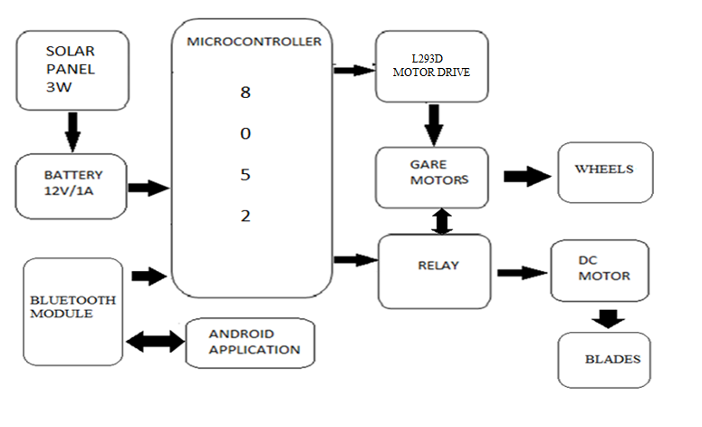
BLOCK DIAGRAM

Slide 4
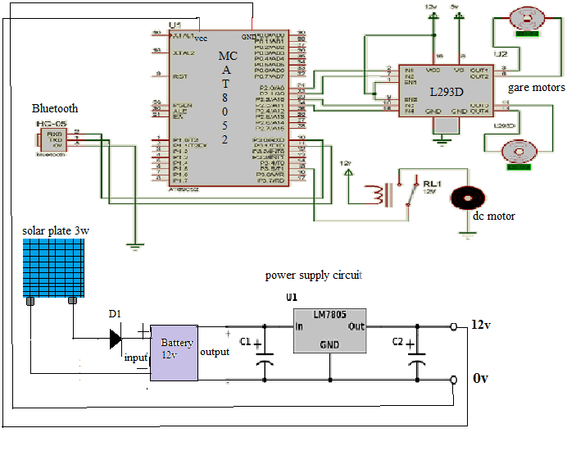
CIRCUIT DIAGRAM

Slide 5
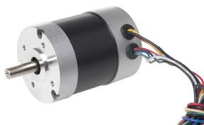
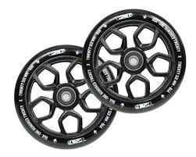
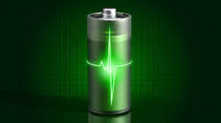
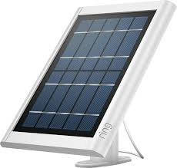
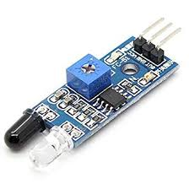
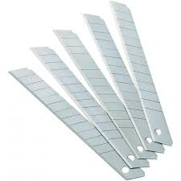

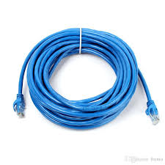

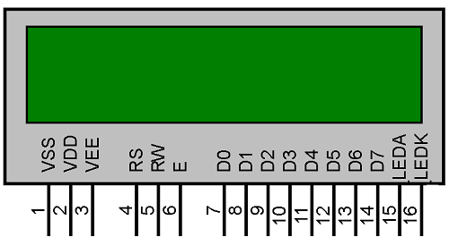
COMPONENTS
DC Motors
Wheel
Battery
Solar panel
IR sensor
Blades
Android application
Connecting wires
Bluetooth device
Microcontroller

Slide 6
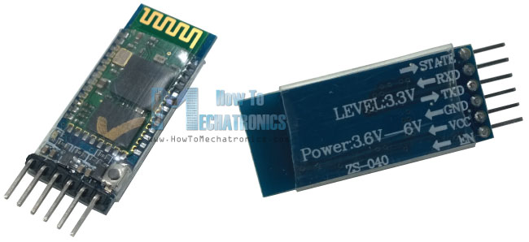
BLUETOOTH MODULE
To setup Wireless Serial Communication, HC-05 Bluetooth Module is most demanding and popular due to its low price and extremely high features.
This module can be used in Master or Slave Mode and easy switchable between these two modes, By default Slave mode is configured. Modes can be changed using AT Commands.

Slide 7
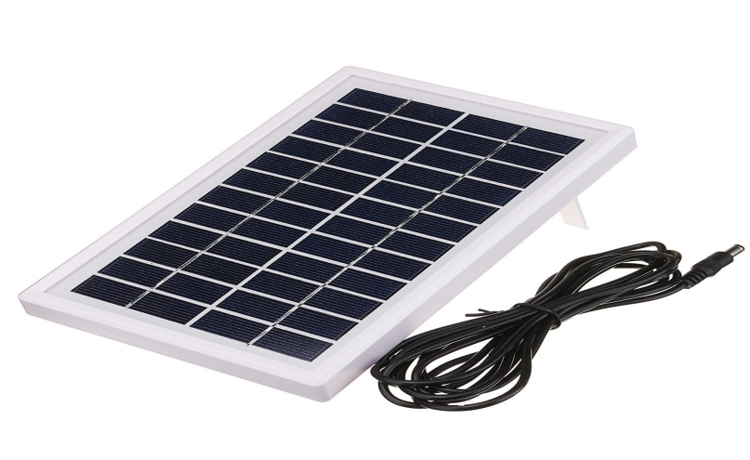
SOLAR PANEL:3W
Solar panels are made out of photovoltaic cells (which is why generating electricity with solar panels is also called solar PV) that convert the sun’s energy into electricity.

Slide 8
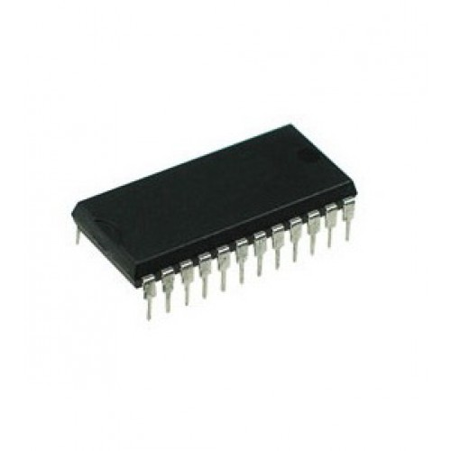
8052 MICRO CONTROLLER:
Microcontroller sporting a number of additional features which the developer may make use of 256 bytes of Internal RAM.
A third 16-bit timer, capable of a number of new operation modes and 16-bit reloads. Additional SFRs to support the functionality offered by the third timer.

Slide 9
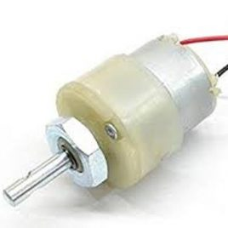
GEAR MOTORS:
A gear motor is a specific type of electrical motor that is designed to produce high torque while maintaining a low horsepower, or low speed, motor output

Slide 10
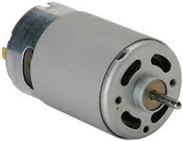
DC MOTOR
A DC motor is any of a class of rotary electrical machines that converts direct current electrical energy into mechanical energy. The most common types rely on the forces produced by magnetic fields.

Slide 11
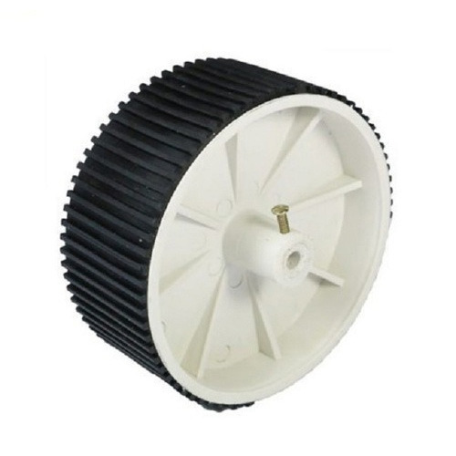
WHEELS:
Wheel is connected to the gear motors and make to move grass cutter from one place to another place.

Slide 12
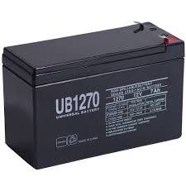
BATTERY:
Batteries have three parts, an anode(-), a cathode(+), and the electrolyte . The cathode and anode (the positive and negative sides at either end of a traditional battery) are hooked up to an electrical circuit.

Slide 13
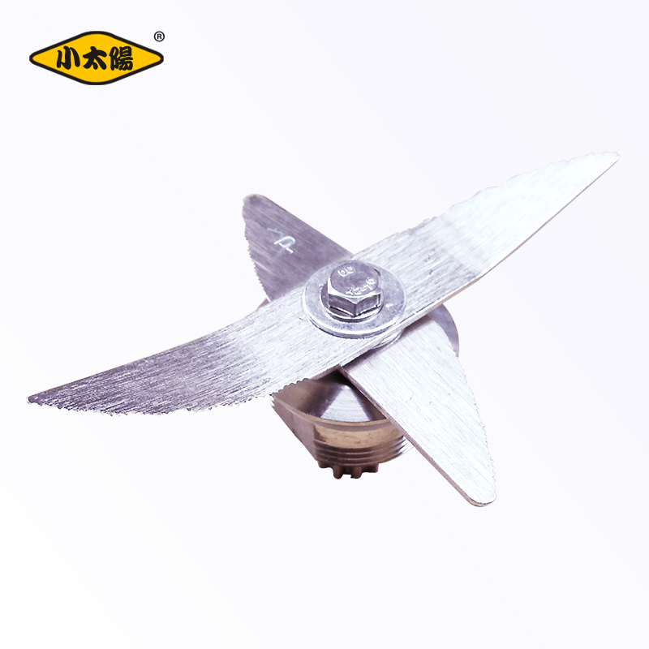
BLADES:
Mover blades are the cutting components of lawn motors. They are usually made of sturdy metals as they must be able to withstand high-speed contact with a variety of objects in addition to grass

Slide 14
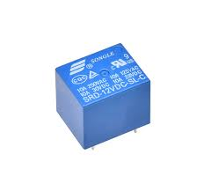
RELAY
Relays are switches that open and close circuits electromechanically or electronically.
.

Slide 15
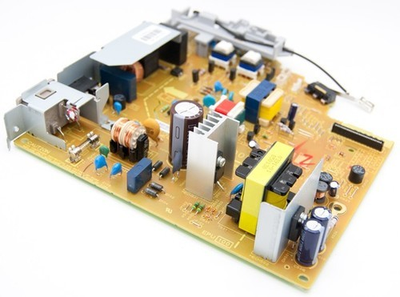
POWER SUPPLY
A power supply is an electrical device that supplies electric power to an electrical load. The primary function of a power supply is to convert electric current from a source to the correct voltage, current, and frequency to power the load.

Slide 16
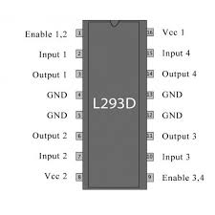
MOTOR DRIVE
L293D is a dual H-bridge motor driver integrated circuit (IC). Motor drivers act as current amplifiers since they take a low-current control signal and provide a higher-current signal. This higher current signal is used to drive the motors.

Slide 17
WORKING
Our project proposes a robotic vehicle that can be handled remotely through an android based device. The control device is integrated with a Bluetooth device that allows capturing and reading the commands. The robotic vehicle may then be operated as desired as commanded through the android application.

Slide 18
ADVANTAGES
Compact size and portable.
Easy to move from one place to another place
Operating principle is simple.
Non-skilled person also operate this machine

Slide 19
DISADVANTAGES
The eventually disposal of batteries is problematic.
Difficult to operate in rainy seasons.

Slide 20
APPLICATIONS
It is used in Parks and Stadium.
All gardens & All Playgrounds.

Slide 21
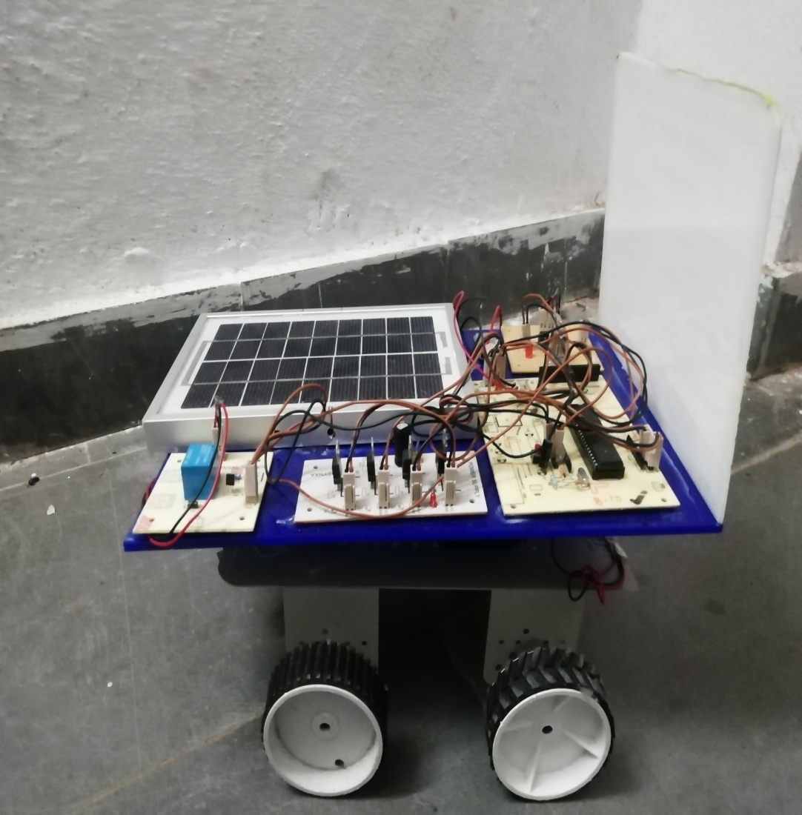
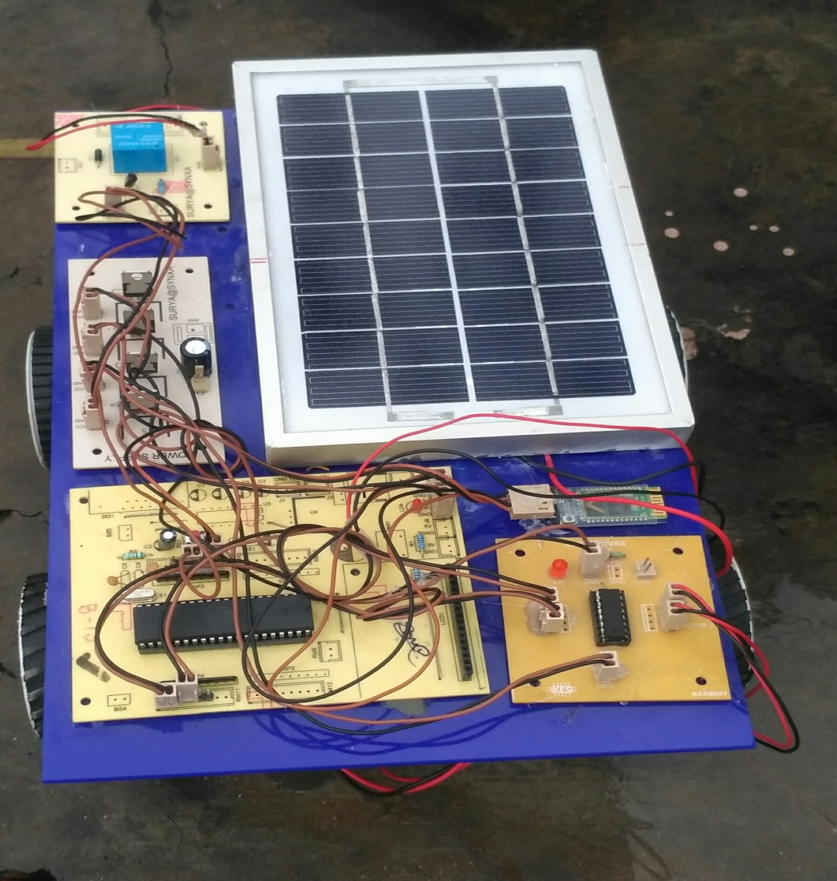
PROJECT OUTPUT PICTURE

Slide 22
CONCLUSION
The conclusion of our project is to cut the grass without using the man power. We used solar energy to cut the grass by saving electric supply. Our project proposes a robotic vehicle that can be handled remotely through an android based device. The control device is integrated with a Bluetooth device that allows capturing and reading the commands. The robotic vehicle may then be operated as desired as commanded through the android application.
Finally, it does not require any skilled person for operating the grass cutter.

Slide 23
THANK YOU
TO
ALL

